Slide 1
ENSE 477
Scrum Report-Out
t2ee
Zuoxiu Xing
2020/01/28

Slide 2

Project deats
Remind me what you are doing
  Web portal that utilizes OpenStack API and services
  Self-service VM deployment platform
Notes:
I am trying to make a self-service virtual machine deployment platform which is a web portal that utilize openstack api and services

Slide 3

Progress review
How did you address previous scrum comments?
  Lo-fi prototype
  Angular for front end framework
Notes:
There were mainly two comments about the project. The purpose: why I am making this and the complexity.

Slide 4
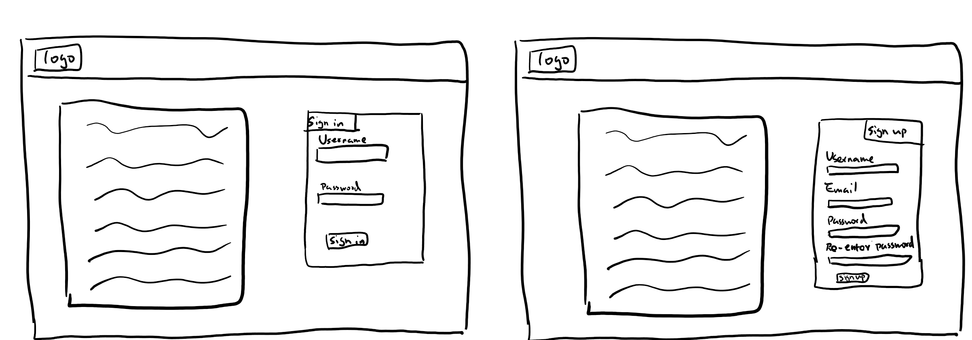
Main page
Notes:
I found this keynote online and explains why I am building this very well.
This is what the user think openstack is doing

Slide 5
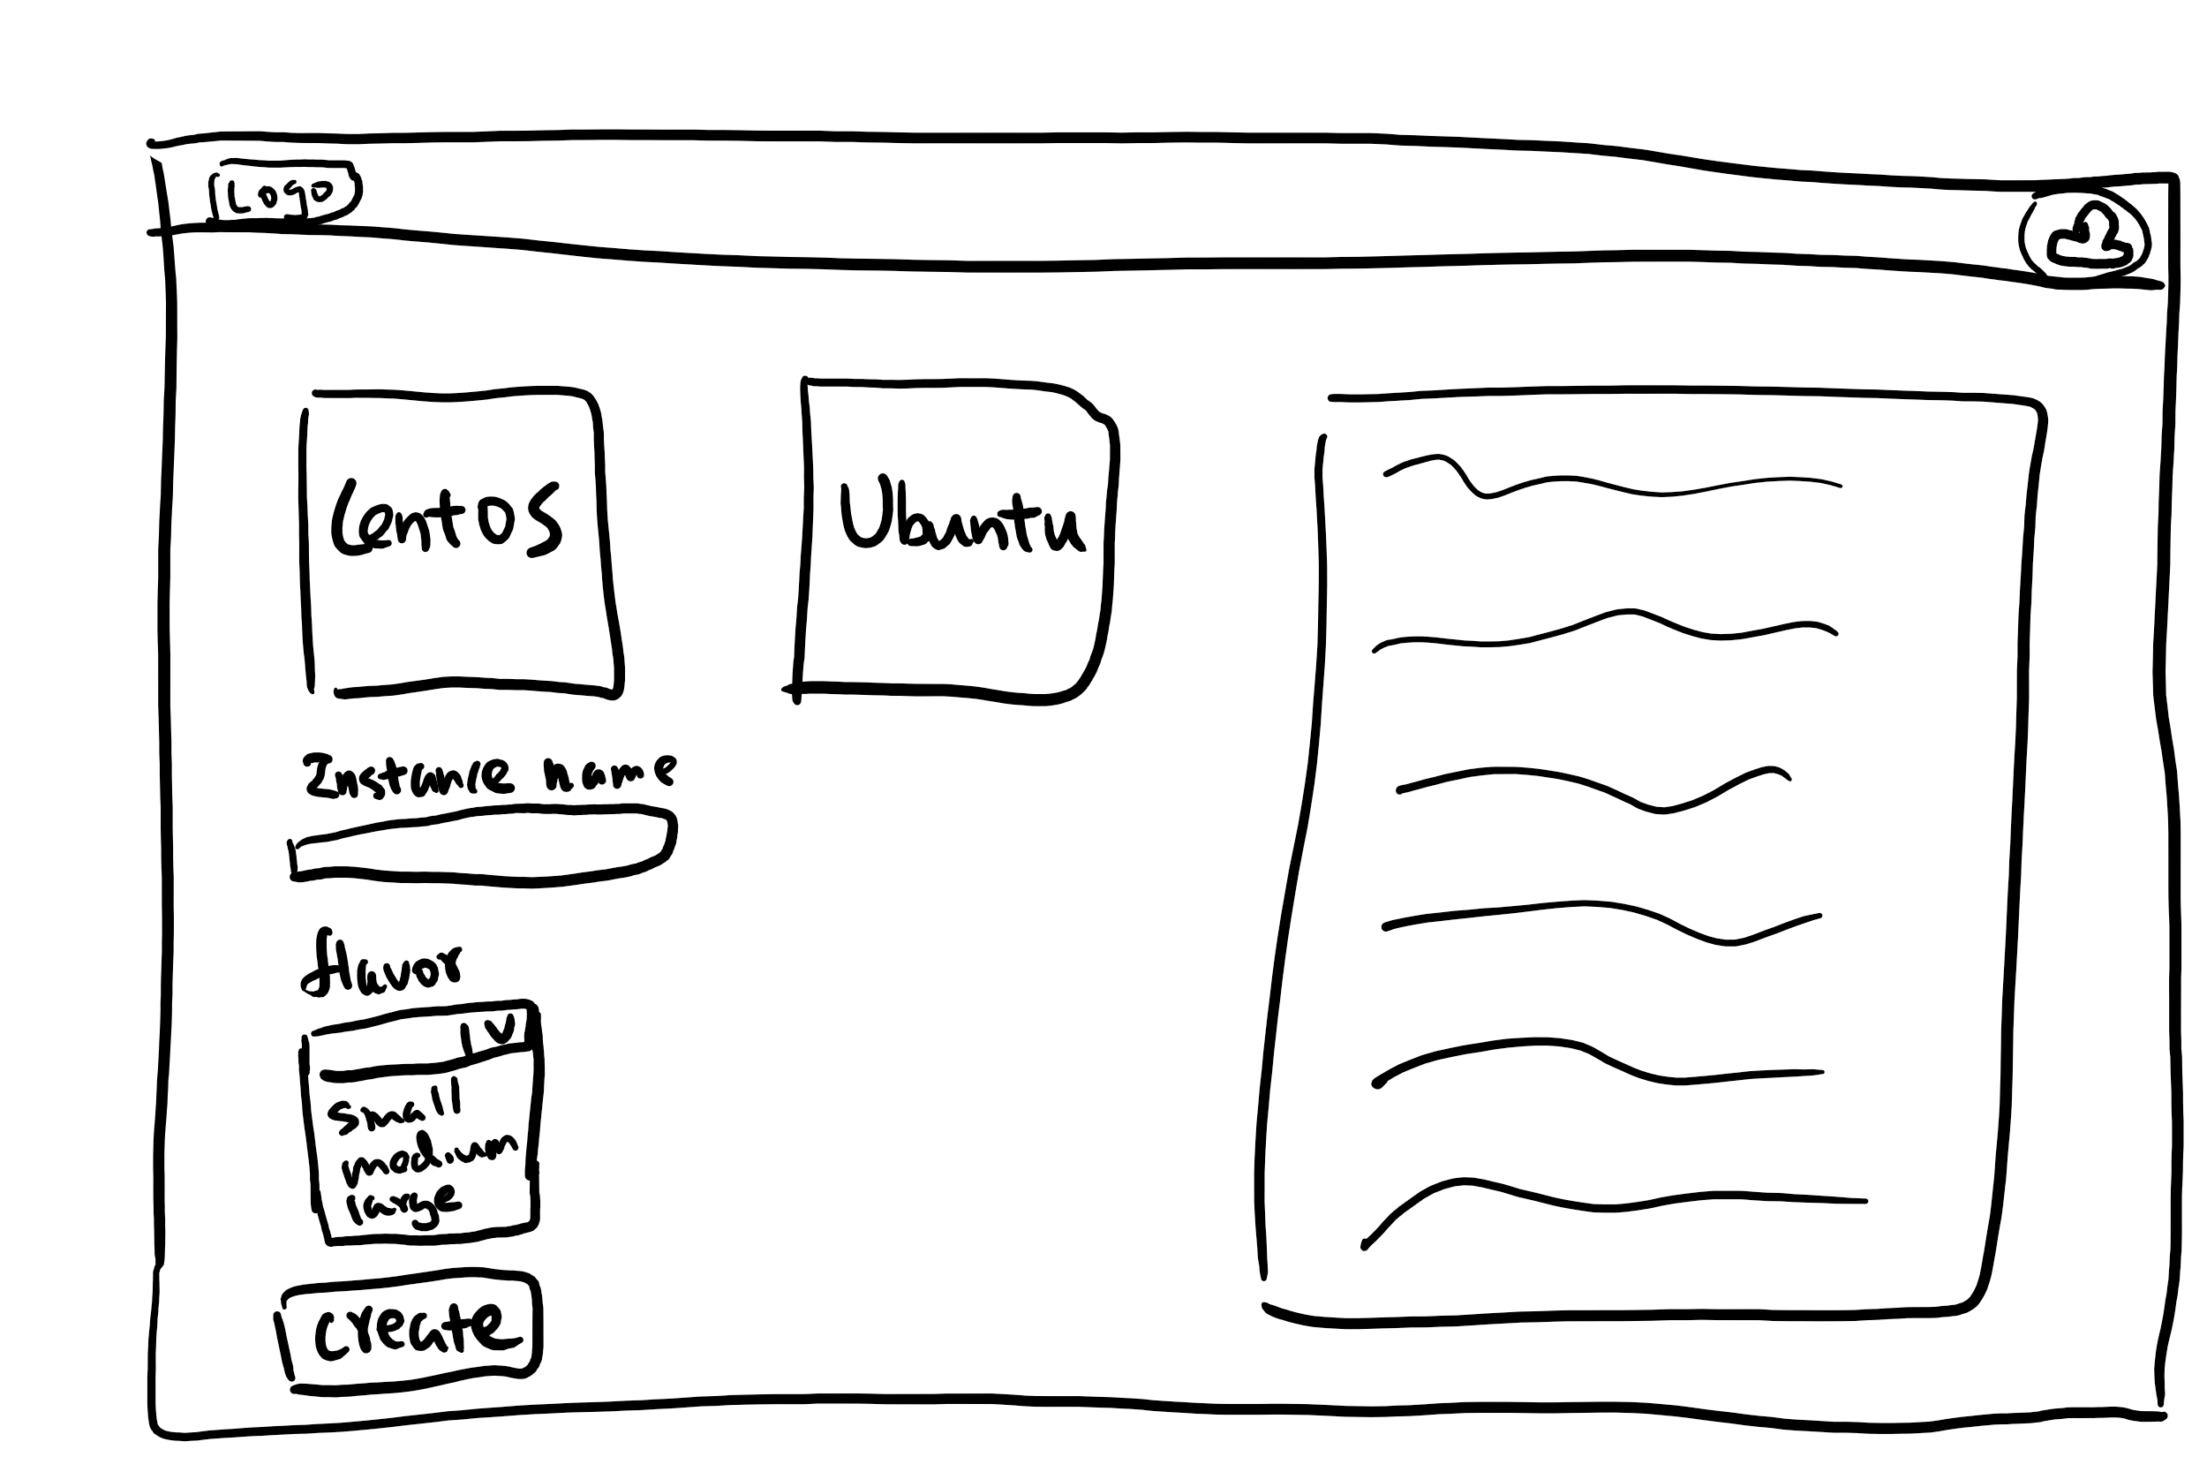
Deployment page
Notes:
I found this keynote online and explains why I am building this very well.
This is what the user think openstack is doing

Slide 6
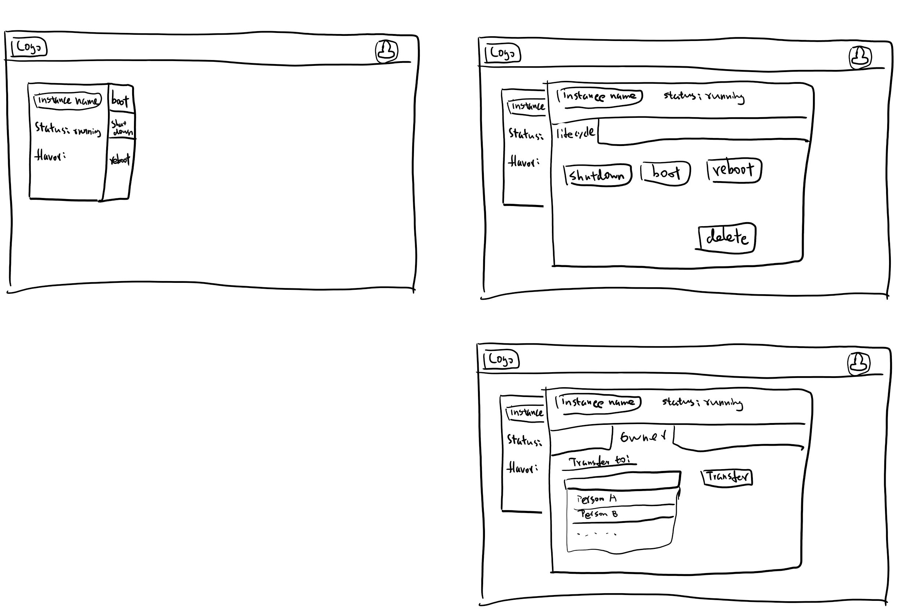
Instance management page
Notes:
I found this keynote online and explains why I am building this very well.
This is what the user think openstack is doing

Slide 7
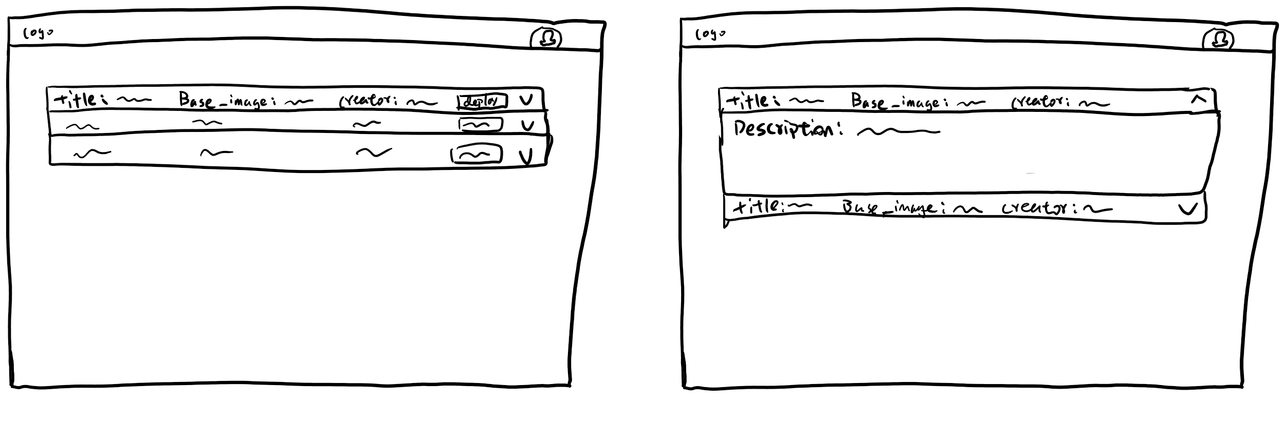
Image inventory page
Notes:
I found this keynote online and explains why I am building this very well.
This is what the user think openstack is doing

Slide 8
Angular
Reasons for choosing angular:
  Previous experience with AngularJS
  Component based
  Material design
  Angular CLI
  Both unit test and end to end test
Notes:
First of all, I have previous experience with AngularJS, which is the 1.x version. Then Google rewrote the entire framework with typescript
Second, it is component based. It makes easier to develop front end since every UI element can be a component
Third, it has Google's material design so that I don’t need to find another CSS library
And Angular CLI to generate component, serving the app, etc. Just makes life easier

Slide 9
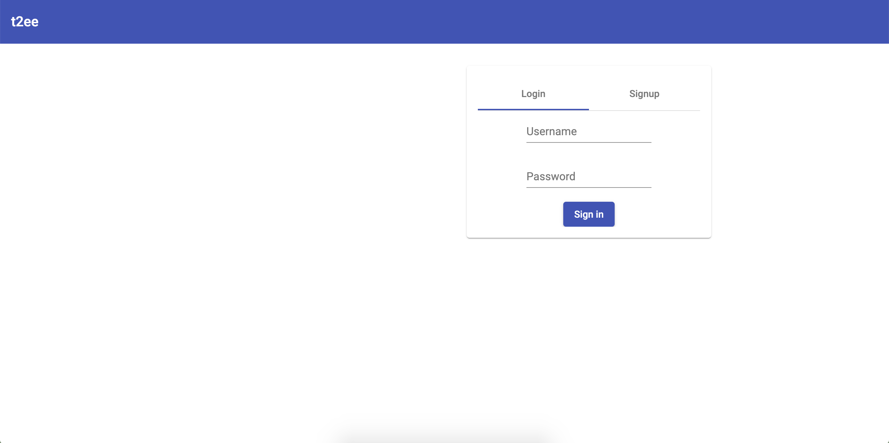
Login page
Notes:
I found this keynote online and explains why I am building this very well.
This is what the user think openstack is doing

Slide 10
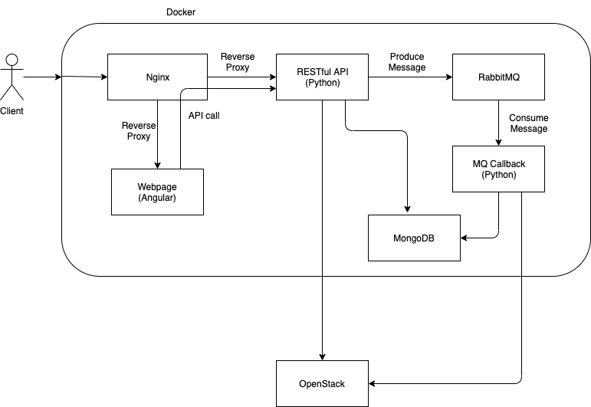
Block Diagram

Slide 11

Group reflection
Do you feel you are on track?
  Yes
Do you feel there are barriers to your success (if any)?
  Steep learning curve of Angular
Do you need any help going forward?
  All good for now
Any other questions or concerns?
  Documents
Notes:
Test plan on syllabus
Developing in marking rubric

Slide 12
Image refs
Show me what you got, https://pictures.abebooks.com/isbn/9781548899530-us-300.jpg
Patrick, https://imgflip.com/memetemplate/43274976/spongebob-patrick-nail-saw
Dilbert, http://4.bp.blogspot.com/-tVbJsudDNaw/T29WxQ0PHZI/AAAAAAAAABc/UlTwD2gkzA4/s1600/Dilbert%2520Software%2520Demo%5B1%5D.jpg
Pondering, https://imgflip.com/s/meme/Question-Rage-Face.jpg

